Slide 1
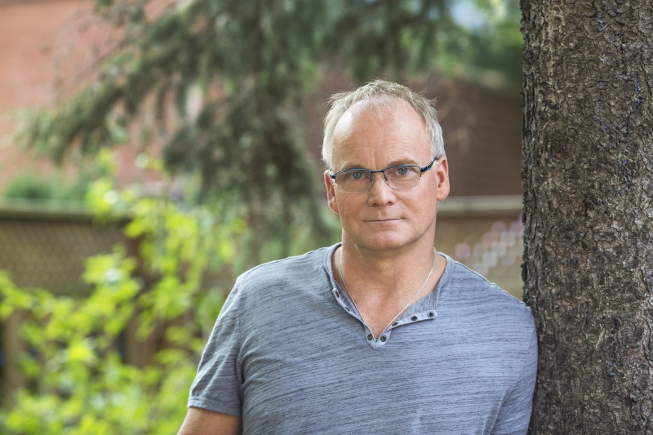
I Can Only Imagine
Scott Jackson - 2016

Slide 2
Revelation 21:2
I saw the Holy City, the new Jerusalem, coming down out of heaven from God,

Slide 4
Revelation 21:2
I saw the Holy City, the new Jerusalem, coming down out of heaven from God,

Slide 5
Revelation 21:2
I saw the Holy City, the new Jerusalem, coming down out of heaven from God, prepared as a bride beautifully dressed for her husband

Slide 6
Revelation 21:5
He who was seated on the throne said, “I am making everything new.”

Slide 7
Revelation 21:4
He will wipe away every tear from their eyes, and death shall be no more, neither shall there be mourning, nor crying, nor pain anymore, for the former things have passed away

Slide 8
Psalm 56:8
He saves our tears in a bottle.

Slide 9
Revelation 5:13
Then I heard every creature in heaven and on earth and under the earth and on the sea, and all that is in them, saying: "To him who sits on the throne and to the Lamb be praise and honor and glory and power, for ever and ever!"

Slide 11
Revelation 4:6
In the center, around the throne, were four living creatures, and they were covered with eyes, in front and in back. The first living creature was like a lion, the second was like an ox, the third had a face like a man, the fourth was like a flying eagle.

Slide 12
Amazement
Worship
Repeat

Slide 13
Thank you!
scott@lifeonline.fm

