Slide 1
Values | What is important living in a post-Christian world
1 October 2023 | Michael Bells

Slide 2
For the first time in some 2000 years,
we have to learn how to do mission
in a setting that is post-Christian
rather than pre-Christian

Slide 3
Acts 2:42-44
They devoted themselves to the apostles’ teaching and to fellowship, to the breaking of bread and to prayer. Everyone was filled with awe at the many wonders and signs performed by the apostles. All the believers were together and had everything in common.

Slide 4
Acts 2:45-47
They sold property and possessions to give to anyone who had need. Every day they continued to meet together in the temple courts. They broke bread in their homes and ate together with glad and sincere hearts, praising God and enjoying the favor of all the people. And the Lord added to their number daily those who were being saved.

Slide 5

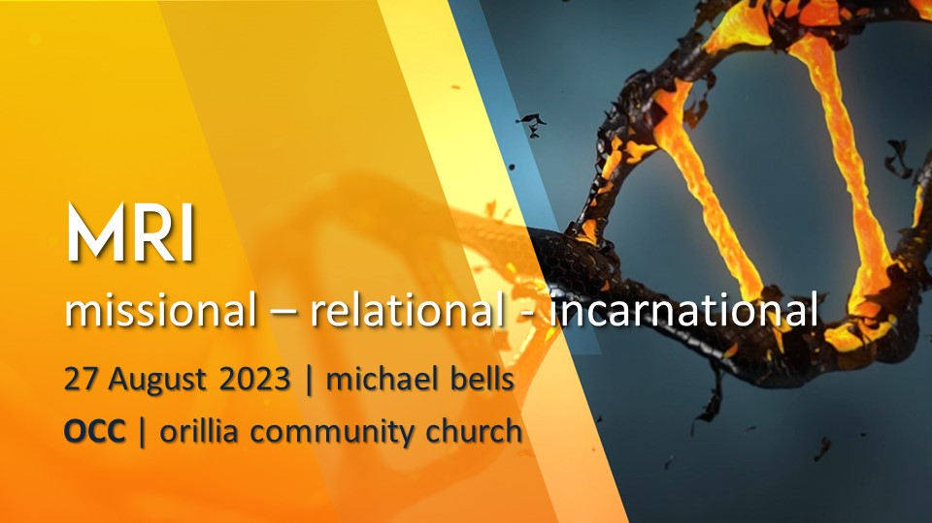

Slide 6
Matthew 28:16-20
Then the eleven disciples went to Galilee,
to the mountain where Jesus had told them to go.
When they saw him,
they worshiped him;
but some doubted.

Slide 7
Matthew 28:16-20
Then Jesus came to them and said,
“All authority in heaven and on earth has been given to me.

Slide 8
Matthew 28:16-20
Therefore go and make disciples
of all nations, baptizing them
in the name of the Father and
of the Son and of the Holy Spirit,
and teaching them
to obey everything
I have commanded you.

Slide 9
occweb.org/sermons/mri-michael-bells/

Slide 10
The missional mindset
is to go and lift-up Christ – everywhere
The relational mindset:
“What is truth?”
The first thing that comes to mind is Jesus
The incarnational mindset
means that the gospel will sound and look differently in all cultures
Notes:
[CLICK] each line

Slide 11
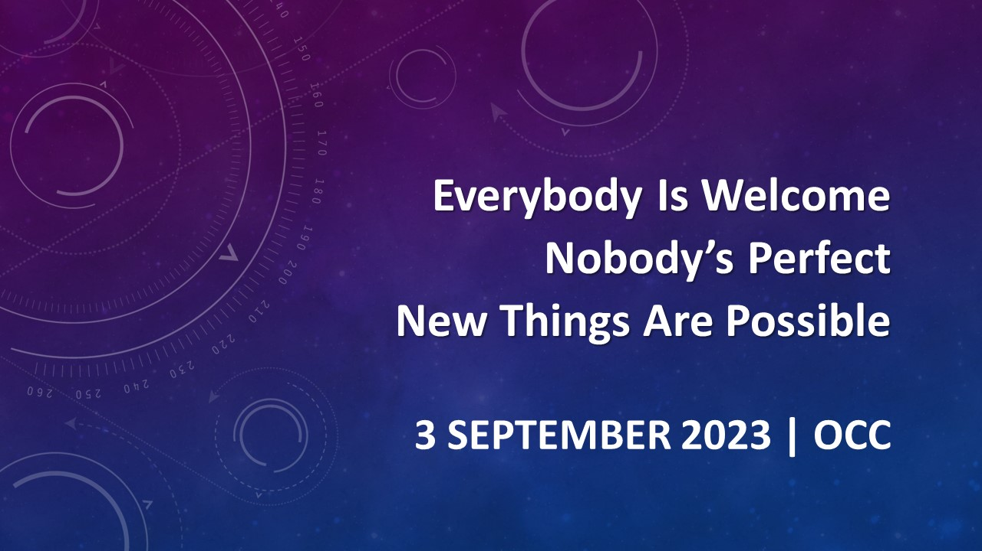

Slide 12
John 13:34-35
A new command I give you:
Love one another.
As I have loved you, so you must love
one another. By this everyone will know that you are my disciples,
if you love one another.

Slide 13
If we don’t live love
we are just making a lot of noise

Slide 14
Gospels
Matthew
Mark
Luke
John

Slide 15
Acts
Picture of the impact of Jesus’ life and ministry in the life of His followers and their new community – the church.
Filled with the promised Holy Spirit, this community begins to live out and declare Jesus’ kingship and kingdom to the world.

Slide 16
kingdom focused values
Truth & Meaning
Beauty & Worship
Authentic Community
Missional Journey

Slide 17
gospel | good news

Slide 18

The gospel of sin management

Slide 19
Scot McKnight “The King Jesus Gospel”
“the story of Jesus of Nazareth
is told as the climax of the long story of Israel,
which in turn is the story
of how the one true God is rescuing the world.”

Slide 20
The gospel is framed by Israel's story.
The story of Jesus:
his life,
death,
resurrection,
exaltation, and
return –
is the completion
of Israel's story.
The gospel centers on
the lordship of Jesus.
He is messiah and king.
The gospel summons
people
to respond:
to repent,
to place faith in Jesus,
and be baptized.
The gospel saves and
redeems.

Slide 21
The gospel is not so much
about “making a decision”
as it is about a lifestyle
of obedience – of discipleship
in the context of authentic community
for the sake of others

Slide 22


Slide 23
Matthew 4:23
Jesus went throughout Galilee,
teaching in their synagogues,
proclaiming the good news
of the kingdom,
and healing every disease
and sickness among the people.

Slide 24
Luke 4:18-19
The Spirit of the Lord is on me,
because he has anointed me
to proclaim good news to the poor.
He has sent me to proclaim freedom
for the prisoners
and recovery of sight for the blind,
to set the oppressed free,
to proclaim the year of the Lord’s favor.

Slide 25


Slide 26
kingdom focused values
Truth & Meaning
Beauty & Worship
Authentic Community
Missional Journey

Slide 27
Truth
Meaning

Slide 28
John 14:6
Jesus answered, “I am the way and the truth and the life. No one comes to the Father except through me
John 8:31-32
Jesus said, “If you hold to my teaching, you are really my disciples. Then you will know the truth, and the truth will set you free.”
Notes:
[CLICK] John 8

Slide 29
God’s revealed truth
Scripture not only gives
reliable historical knowledge
about how God acts in the daily world;
it gives unique theological knowledge
about what God is like
and why He acts.

Slide 30
Truth
Notes:
Truth is a loaded word in our culture

Slide 31
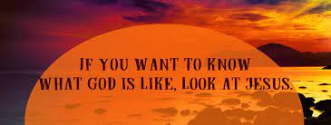

Slide 32


Slide 33
John 1:1-14
In the beginning was the Word,
and the Word was with God,
and the Word was God.
He was with God in the beginning. Through him all things were made; without him nothing was made that has been made. In him was life, and that life was the light of all mankind.

Slide 34
John 1:1-14
The light shines in the darkness,
and the darkness has not overcome it. There was a man sent from God whose name was John. He came as a witness
to testify concerning that light,
so that through him all might believe. He himself was not the light;
he came only as a witness to the light.

Slide 35
John 1:1-14
The true light that gives light
to everyone was coming into the world. He was in the world, and though the world was made through him,
the world did not recognize him.
He came to that which was his own,
but his own did not receive him.

Slide 36
John 1:1-14
Yet to all who did receive him,
to those who believed in his name,
he gave the right to become children of God – children born not of
natural descent, nor of human decision or a husband’s will,
but born of God.

Slide 37
John 1:1-14
The Word became flesh
and made his dwelling among us.
We have seen his glory,
the glory of the one and only Son,
who came from the Father,
full of grace and truth.

Slide 38
2 Timothy 3:15-17
...and how from infancy you have known the Holy Scriptures, which are able to make you wise for salvation through faith in Christ Jesus.
All Scripture is God-breathed and is useful for teaching, rebuking, correcting and training in righteousness, so that all God’s people may be thoroughly equipped for every good work.

Slide 39
We don’t measure a church
by attendance & budget…
We measure it by the quality of community that disciples people to love well;
that equips people to live life with God
and a commitment to work for healing
in all areas of life in the way of Jesus.

